Slide 1
Deep Learning with Tensorflow
Part I

Slide 2
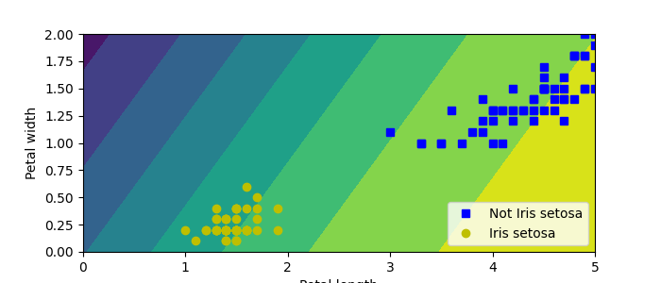
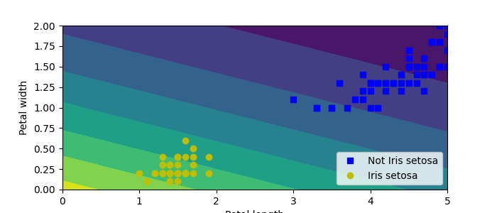
Perceptron Code (tensorflow)
1
2
3
4
5
6
7
8
9
10
11
12
13
14
15
16
17
18
19
from sklearn.datasets import load_iris
from tensorflow.keras.models import Sequential
from tensorflow.keras.layers import Dense
from tensorflow.keras.losses import BinaryCrossentropy
def main():
iris = load_iris()
X = iris.data[:,(2,3)] # petal length, petal width
y = (iris.target == 0).astype(int) # iris setosa?
# Create model, train on data
layer1 = Dense(units=1, activation="sigmoid")
model = Sequential( layer1 )
model.compile( optimizer="sgd", loss=BinaryCrossentropy() )
model.fit(X,y)
# Evaluate (i.e. predict)
y_pred_prob = model.predict( [[2, 0.5]] )
if __name__ == "__main__":
main()

Slide 3
Regression with Tensorflow
1
2
3
4
5
6
7
8
9
10
11
12
13
14
15
16
# Define the training data: input xs and answers ys
# dtype clue that TF is not python because most tf.types are c++, not python types
# The function (aka rule) to map x -> y, y = 2x - 1
xs = np.array( [-1.0, 0.0, 1.0, 2.0, 3.0, 4.0], dtype=float )
ys = np.array( [-3.0, -1.0, 1.0, 3.0, 5.0, 7.0], dtype=float )
# The input is one data value, model has one neuron, output is one value
# All models in TF must have an optimizer and a loss function
model = keras.Sequential( [keras.layers.Dense(units=1, input_shape=[1])] )
model.compile( optimizer="sgd", loss="mean_squared_error" )
# Learn the function that maps x to y
# Iterate enough times, more usually means better approximation too true function
model.fit( xs, ys, epochs=500 )
# Evaluate the model to see how well it learned the function
print( model.predict([10.0]) )

Slide 4
Data Sets
Randomly split into 2 or 3 sets
Typical percentage splits are 60/20/20 train/val/test
Test is proxy for how well model generalizes
data
X_train, X_test, y_train, y_test = train_test_split(X, y, test_size=0.20)
X_train, X_val, y_train, y_val = train_test_split(X_train, y_train, test_size=0.25)
Train
Validation
Test

Slide 5

Image Classifier (not a CNN)
a⁰₁
g(.)
0.05 | "T-shirt/top"
0.05 | "Trouser"
0.05 | "Pullover"
0.05 | "Dress"
0.05 | "Coat"
0.10 | "Sandal"
0.05 | "Shirt"
0.25 | "Sneaker"
0.05 | "Bag"
0.30 | "Ankle boot"
g(.)
g(.)
a⁰₂
g(.)
...
...
...
...
g(.)
g(.) = softmax
g(.)
28 x 28
g(.)
1
a⁰
1
1
(28x28)
Input
((28x28), 784)
Flatten Layer
(784, 300)
Dense Layer
(300, 100)
Dense Layer
(100,10)
Dense Output
Feed-forward neural network

Slide 6
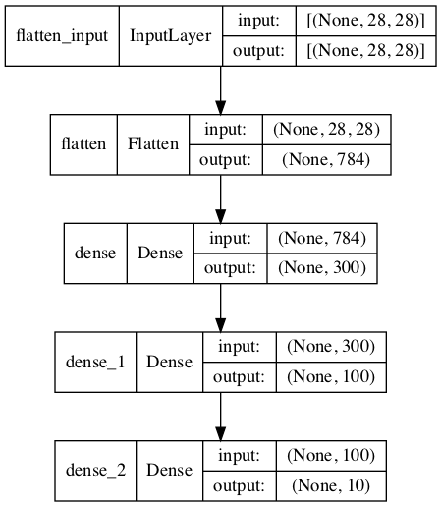
Image Classifier (not a CNN) TF
1
2
3
4
5
6
7
8
9
10
# Create model, train on the data
model = tf.keras.Sequential()
model.add(tf.keras.layers.InputLayer(input_shape=[28, 28]))
model.add(tf.keras.layers.Flatten())
model.add(tf.keras.layers.Dense(300, activation="relu"))
model.add(tf.keras.layers.Dense(100, activation="relu"))
model.add(tf.keras.layers.Dense(10, activation="softmax"))
model.compile(loss="sparse_categorical_crossentropy", optimizer="sgd", metrics=["accuracy"])
history = model.fit(X_train, y_train, epochs=10, validation_data=(X_valid, y_valid))
Layer (type) Output Shape Param #
=================================================================
flatten (Flatten) (None, 784) 0
dense (Dense) (None, 300) 235500
dense_1 (Dense) (None, 100) 30100
dense_2 (Dense) (None, 10) 1010
=================================================================
Total params: 266,610
Trainable params: 266,610
Non-trainable params: 0
# Hand estimation of the number of parameters
# Do not forget about the biases!
235500 = (784 * 300) + 300
30100 = (300 * 100) + 100
1010 = (100 * 10) + 10

Slide 7
Regression MLP
Sequential Model
Layers ordered as added
Output from previous layer is input to next layer
Layer (type) Output Shape Param #
=================================================================
normalization_1 (Normalize) (None, 8) 17
dense_9 (Dense) (None, 50) 450
dense_10 (Dense) (None, 50) 2550
dense_11 (Dense) (None, 50) 2550
dense_12 (Dense) (None, 1) 51
=================================================================
Total params: 5,618
Trainable params: 5,601
Non-trainable params: 17
(8)
Input
(8,8)
Normal
(8, 50)
Dense
(50, 50)
Dense
(50, 50)
Dense
(50, 1)
Output

Slide 8
Regression MLP Code
1
2
3
4
5
6
7
8
9
10
11
12
13
14
15
16
17
18
19
20
21
22
23
24
25
26
27
28
#=====================================================#
# Load data, load and split the California housing dataset, like earlier
#=====================================================#
housing = fetch_california_housing()
X_train_full, X_test, y_train_full, y_test = train_test_split(housing.data, housing.target, random_state=42)
X_train, X_valid, y_train, y_valid = train_test_split(X_train_full, y_train_full, random_state=42)
#=====================================================#
# Create model
#=====================================================#
norm_layer = tf.keras.layers.Normalization(input_shape=X_train.shape[1:])
model = tf.keras.Sequential([
norm_layer,
tf.keras.layers.Dense(50, activation="relu"),
tf.keras.layers.Dense(50, activation="relu"),
tf.keras.layers.Dense(50, activation="relu"),
tf.keras.layers.Dense(1)
])
model.compile(loss="mse", optimizer="adam", metrics=["RootMeanSquaredError"])
norm_layer.adapt(X_train)
history = model.fit(X_train, y_train, epochs=20, validation_data=(X_valid, y_valid))
#=====================================================#
# Evaluate, predict
#=====================================================#
mse_test, rmse_test = model.evaluate(X_test, y_test)
X_new = X_test[:3]
y_pred = model.predict(X_new)

Slide 9
Sequential and Functional Model
1
2
3
4
5
6
# Sequential Model
model = Sequential()
model.add(InputLayer(input_shape=a0_len))
model.add(Dense(30, activation="relu"))
model.add(Dense(30, activation="relu"))
model.add(Dense(1, activation="linear"))
equivalent, but...
1
2
3
4
5
6
7
8
9
10
11
12
13
14
# Functional Model
# First create layers
input_ = InputLayer(input_shape=a0_len)
hidden1_layer = Dense(30, activation="relu")
hidden2_layer = Dense(30, activation="relu")
output_layer = Dense(1 , activation="linear")
# Now connect layers
hidden1_out = hidden1_layer(input_)
hidden2_out = hidden2_layer(hidden1_out)
output = output_layer(hidden2_out)
model=Model(inputs=[input_],outputs=[output])
(8)
Input
(8, 8)
Normal
(8, 30)
Dense
(30, 30)
Dense
(30, 1)
Output

Slide 10
Wide and Deep Neural Network
Requires Functional Model (short vs deep path)
Layer (type) Output Shape Param # Connected to
===============================================================================
input_1 (InputLayer) [(None, 8)] 0 []
normalization (Normalization) (None, 8) 17 ['input_1[0][0]']
dense (Dense) (None, 30) 270 ['normalization[0][0]']
dense_1 (Dense) (None, 30) 930 ['dense[0][0]']
concatenate (Concatenate) (None, 38) 0 ['normalization[0][0]',
'dense_1[0][0]']
dense_2 (Dense) (None, 1) 39 ['concatenate[0][0]']
===============================================================================
Total params: 1,256
Trainable params: 1,239
Non-trainable params: 17
(8)
Input
(8,8)
Norm
(8, 30)
Dense
(30, 30)
Dense
( [8, 30], 38)
Concat
(39, 1)
Output

Slide 11
Wide and Deep Neural Network
1
2
3
4
5
6
7
8
9
10
11
12
13
14
15
16
1718
19
# Create layers
input_ = tf.keras.layers.Input(shape=X_train.shape[1:])
norm_layer = tf.keras.layers.Normalization()
hidden1_layer = tf.keras.layers.Dense(30, activation="relu")
hidden2_layer = tf.keras.layers.Dense(30, activation="relu")
concat_layer = tf.keras.layers.Concatenate()
output_layer = tf.keras.layers.Dense(1, activation="linear")
# Connect layers according to architecture
norm_output = norm_layer(input_)
hidden1_output = hidden1_layer(norm_output)
hidden2_output = hidden2_layer(hidden1_output)
concat_output = concat_layer([norm_output, hidden2_output])
output = output_layer(concat_output)
model = tf.keras.Model(inputs=[input_], outputs=[output])
# NB: Need to use Adam optimiser, SGD fails to find a solution!
model.compile(loss="mse", optimizer="adam", metrics=["RootMeanSquaredError"])
model.fit(X_train, y_train, epochs=10, validation_data=(X_valid, y_valid))

Slide 12
Training Loop
Each epoch try to adjust weights to reduce loss
Key question: How many epochs? More epochs is always better?
1
2
3
4
5
6
7
8
9
10
11
12
13
14
1516
# Outline of the model.fit function
def fit(X_train, y_train, epochs=10, batch_size=32, learning_rate=0.001)
for epoch in range(1, epochs+1):
# Process in batches, vectorized so larger batches means better performance
loss = 0.0
for step in (len(X_train)//batch_size):
# FORWARD PASS: get batch, predict, determine loss
X_batch, y_batch = random_batch(X_train, y_train)
y_pred = model(X_batch)
batch_loss = loss_fn(y_pred, y_batch)
loss += batch_loss
# BACKWARD PASS: determine which way to move weights to reduce loss
gradients = tape.gradient( batch_loss, model.weights )
# optimise, apply gradient to current weights
model.weights = model.weights + (learning_rate*gradients)
print(f"Epoch {epoch}/{epochs} loss={loss}")

Slide 13
Training Loop
Each epoch try to adjust weights to reduce loss
Run on training data, evaluate on validation/test data
Forward Pass
Backward Pass
W
b
W
b
W
b
W
b
W
b
Loss
W
b
Loss
(8)
Input
(8, 30)
Dense
(30, 30)
Dense
(30, 1)
Output
(8)
Input
(8, 30)
Dense
(30, 30)
Dense
(30, 1)
Output

Slide 14
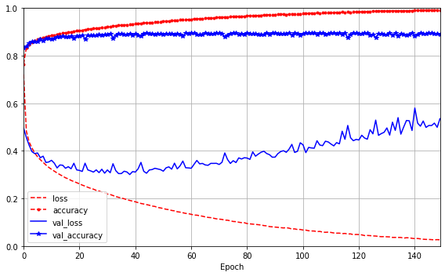
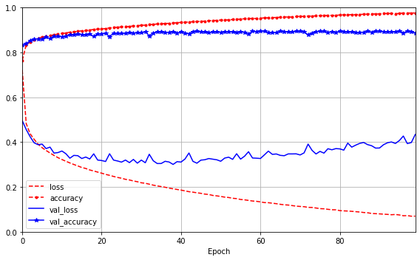
Training Loop - Overfitting
How to save best model based on validation acc?

Slide 15
Saving/Restoring Models
Need to save/restore models
1
2
3
4
5
6
7
8
9
10
11
#=====================================================#
# Save model
#=====================================================#
model = create_model()
model.save("my_keras_model", save_format="json")
#=====================================================#
# Sometime later, restore model
#=====================================================#
model = tf.keras.models.load_model("my_keras_model")
evaluate_model(model)
The fit function can take hours/days
How can we save at checkpoints during fit?
Use callbacks

Slide 16
Callbacks
ModelCheckpoint - saves best model on val set
EarlyStopping – stops training when no improvement on val set
1
2
3
4
5
6
7
8
9
10
11
checkpoint_cb = tf.keras.callbacks.ModelCheckpoint("my_model.h5", save_best_only=True)
early_stopping_cb = tf.keras.callbacks.EarlyStopping(patience=10, restore_best_weights=True)
# Must provide a validation set
history = model.fit(
(X_train_wide, X_train_deep), (y_train, y_train), epochs=200,
validation_data=((X_valid_wide, X_valid_deep), (y_valid, y_valid)),
callbacks=[checkpoint_cb, early_stopping_cb])
# Now load the model that did best on the validation set
model = tf.keras.models.load_model("my_model.h5")

Slide 17
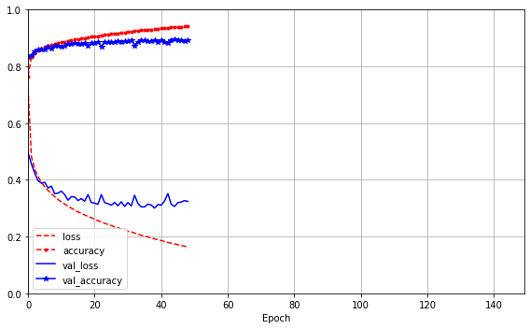
Callbacks – Early Stopping
Saves computation and helps mitigate overfitting
Will explore regularization (e.g. penalty term, dropout)

